Slide 1

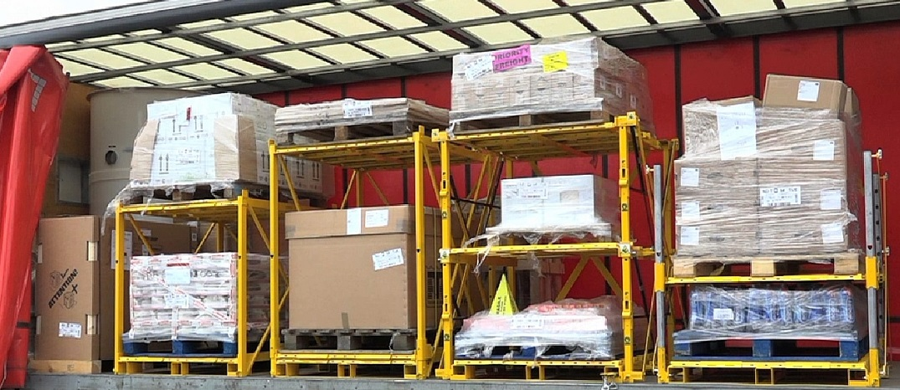
Multistack System
HGV COLLAPSIBLE PALLET STACKING

Slide 2

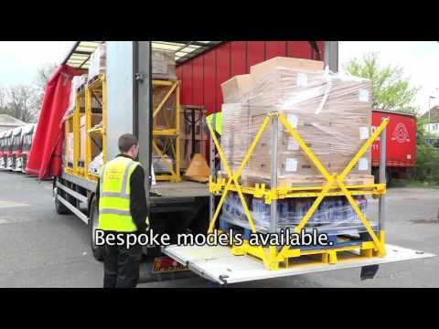
What is the MultiStack range?
Please watch the video below

Slide 3
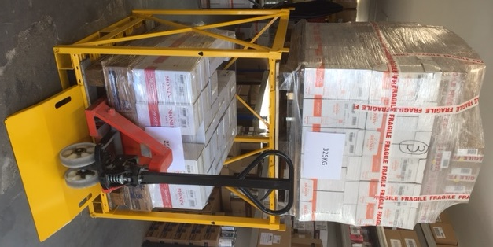
What is the MultiStack range?
Benefits
• Boost your fleet’s potential
• Maximise all available space
• Less damage to goods
• More environmentally friendly
• Competitive pricing edge
• No more part loads
• 2 or 3 pallets in 1 pallet space

Slide 4
What is the MultiStack range?
• Stack up to 3 part pallets in 1 pallet’s space
• Can take 1000 x 1200 UK pallet
• Euro pallet sizes also available
• 600KG carrying capacity on base
• 300KG carrying capacity on each elevated chassis
• A range of 4 different fully collapsible and rigid racks available
• Fully cross braced for stability
• Unloaded by forklift or pallet truck
• Ramp and load runners enable unloading by pallet truck from tail lift
• Built in the UK by an ISO 9001 accredited manufacturer

Slide 5
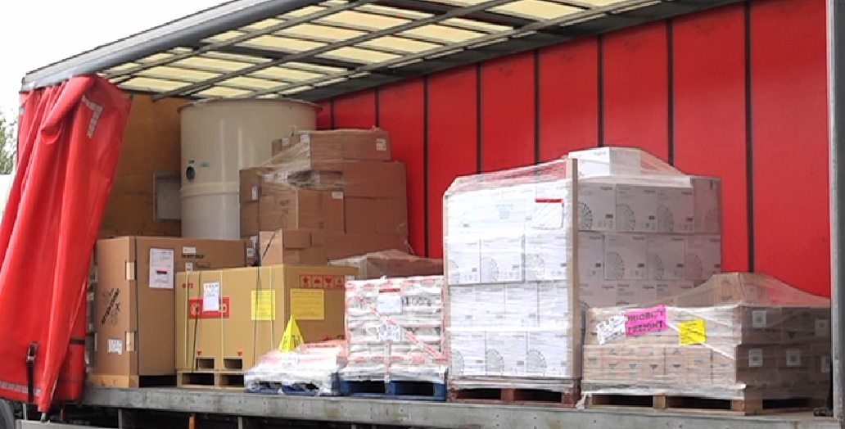
So is your truck really fully loaded?

Slide 6
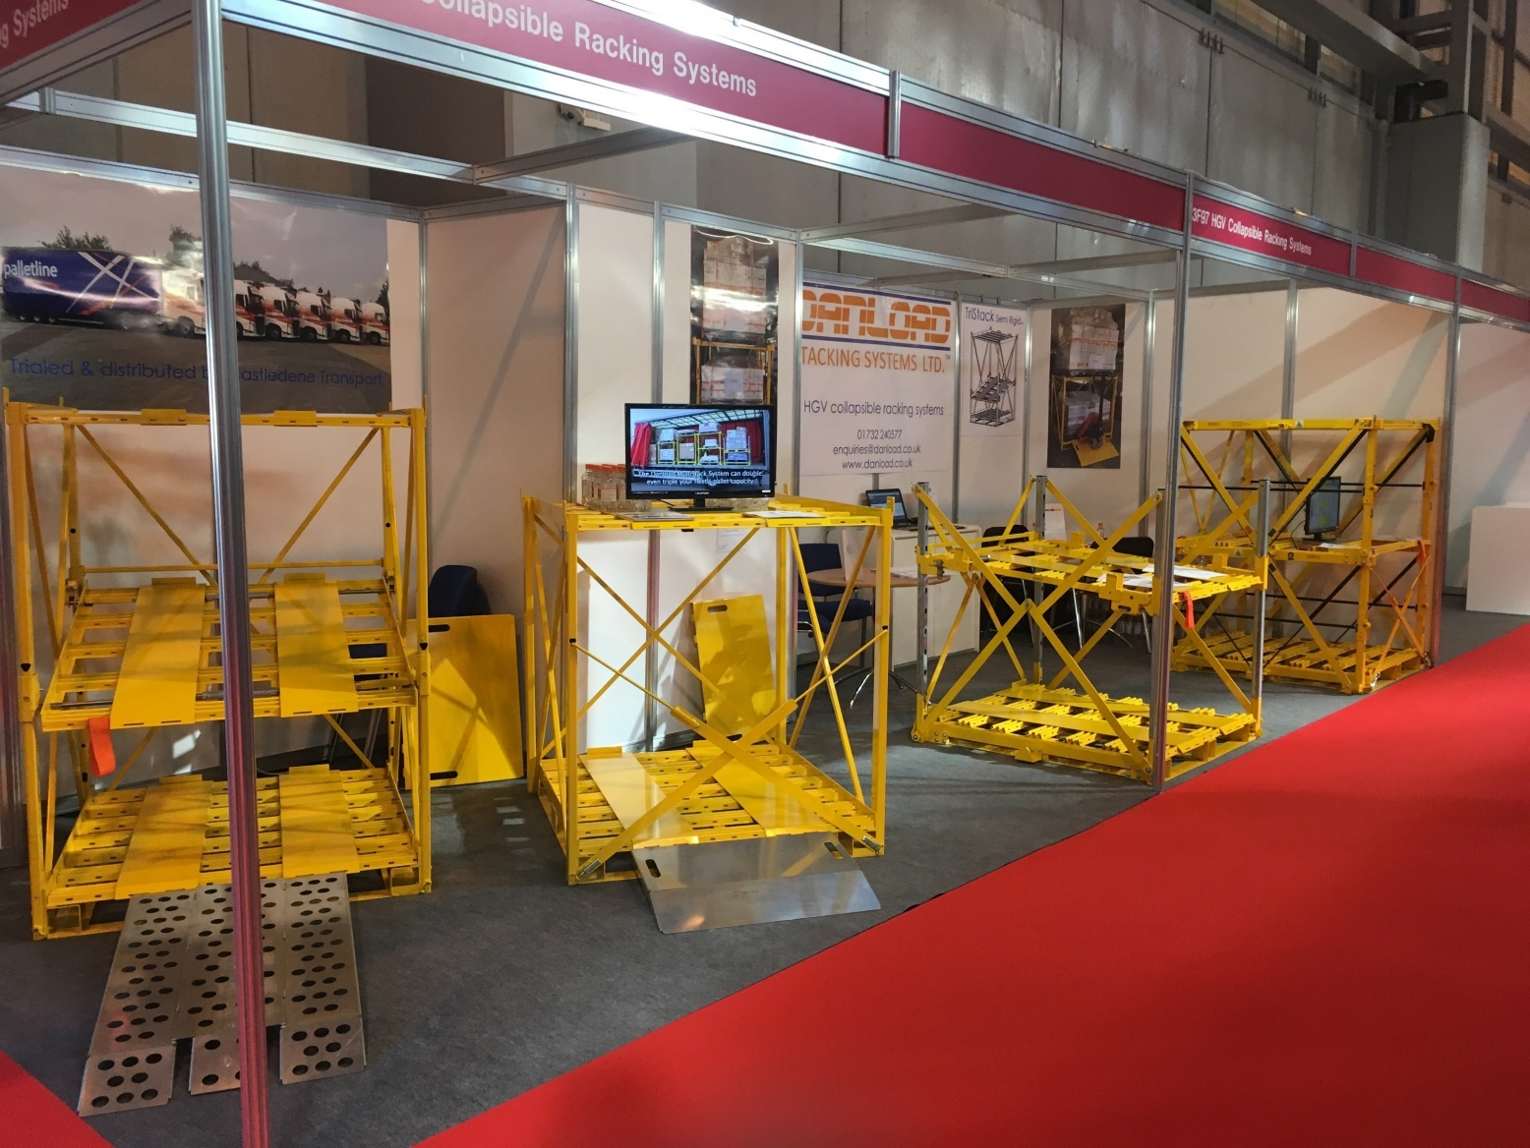
Launched at the
Commercial Vehicle Show 2017

Slide 7
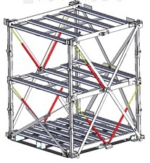
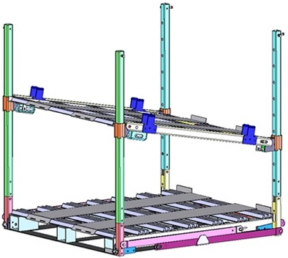
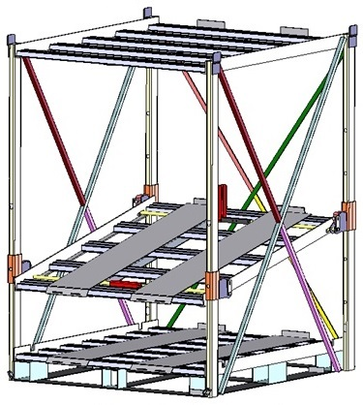
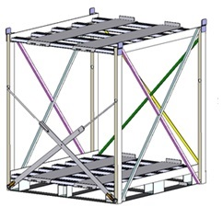
The MultiStack Range
Fully Collapsible Range
TriStack FC1000
DuoStack FC1000
Fixed Range
TriStack SR1000
DuoStack R1000

Slide 8
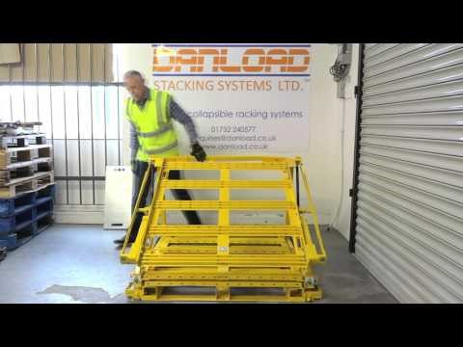
The MultiStack Range
Please watch the video below

Slide 9
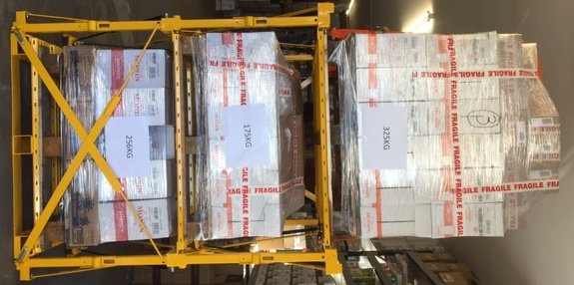
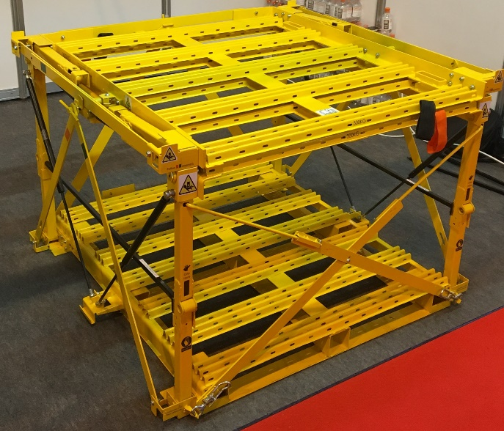
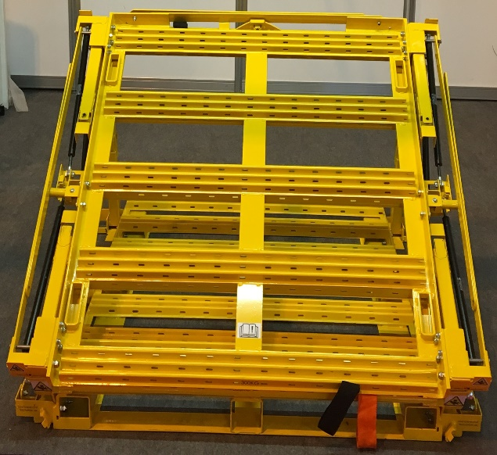
The Collapsible Range
TriStack FC1000
• 1–2–3 pallet options
• Assisted lift & lower mechanism
• Fixed chassis heights
• 200KG net weight
• Can be stacked 5 high when not in use
Overall Dimensions | W 1350 x D 1250 x H 1570 | Weight | 200 KG
Load area base | W 1000 x D 1200 x H 600 | Carrying Capacity | 600 KG
Load area centre | W 1000 x D 1200 x H 600 | Carrying Capacity | 300 KG
Load area top | W 1000 x D 1200 x H unrestricted | Carrying Capacity | 300 KG

Slide 10
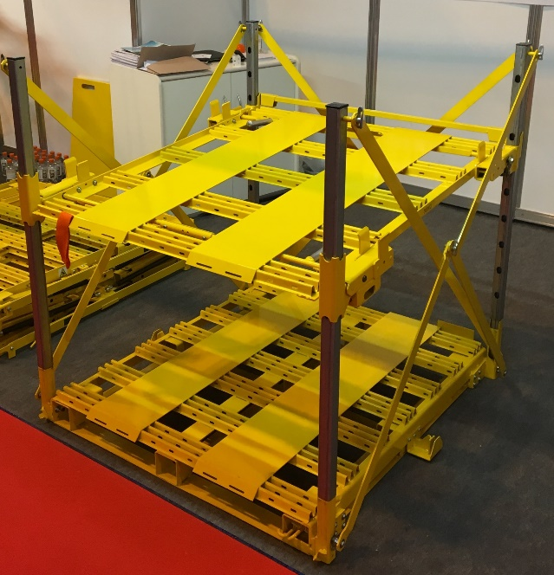
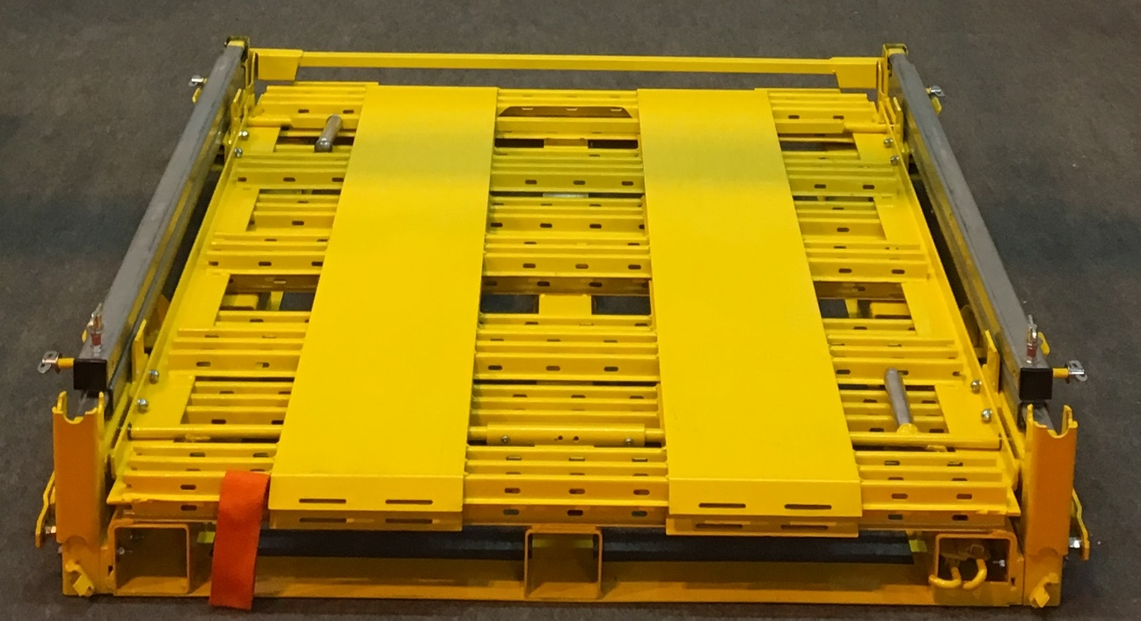
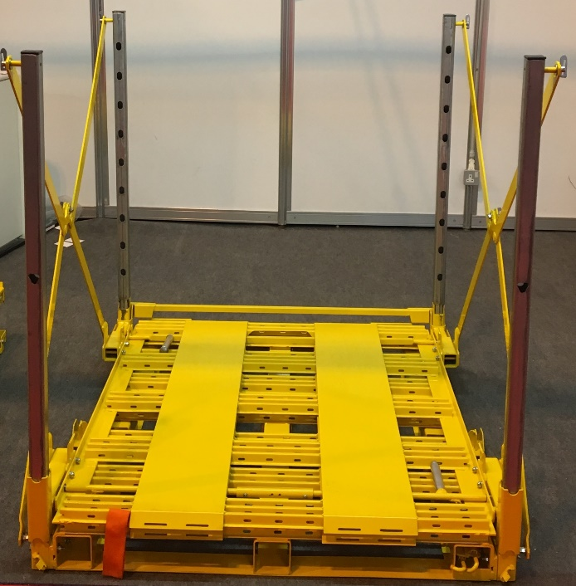
The Collapsible Range
DuoStack FC1000
• 2 part pallets in 1 pallet space
• Chassis adjusted in 200mm increments
• 160KG net weight
Overall Dimensions | W 1250mm x D 1250mm x H 1260mm | Weight | 160 KG
Load area base | W 1000mm x D 1200mm x H variable up to 1000mm | Carrying Capacity | 600 KG
Load area top | W 1000mm x D 1200mm x H unrestricted | Carrying Capacity | 300 KG

Slide 11
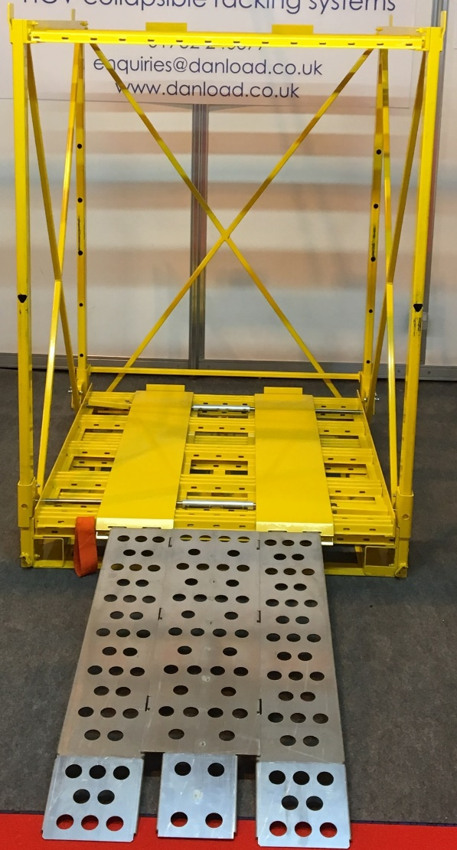
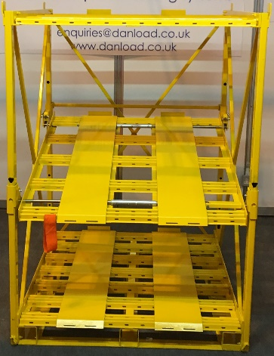
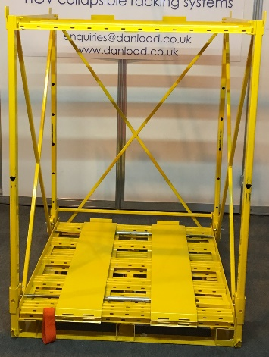
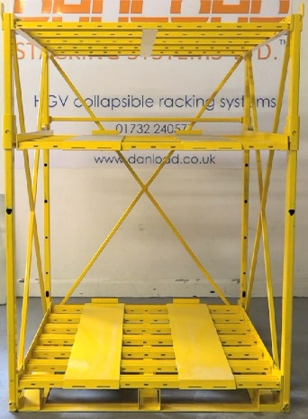
The Fixed Range
TriStack SR1000
• Up to 3 part pallets in 1 pallet space
• Centre chassis adjusts in 200mm increments
• Ideal for getting weight at front on double stacking trailers
• 200KG net weight
• Can be stacked 3 high when not in use
Overall Dimensions | W 1200mm x D 1260mm x H 1570mm | Weight | 200 KG
Load area base | W 1000mm x D 1200mm x H variable 250mm – 650mm | Carrying Capacity | 600 KG
Load area centre | W 1000mm x D 1200mm x H variable 600mm–1300mm | Carrying Capacity | 300 KG
Load area top | W 1000mm x D 1200mm x H unrestricted | Carrying Capacity | 300 KG

Slide 12
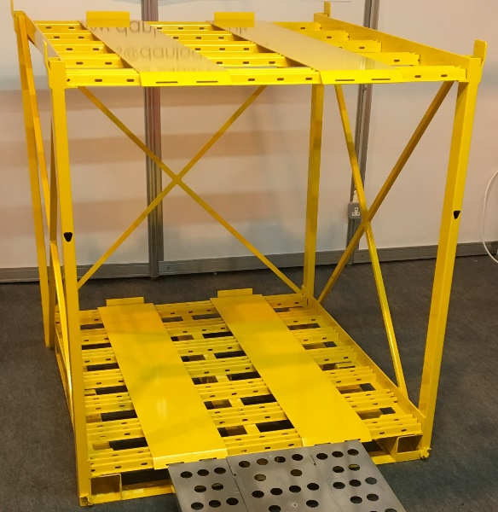
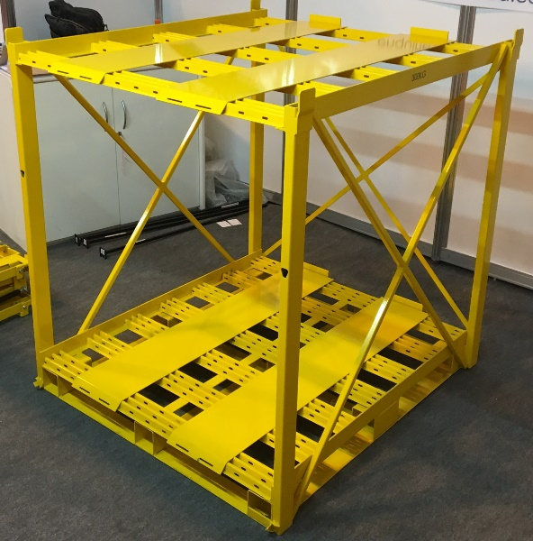
The Fixed Range
DuoStack R1000
• 2 part pallets in 1 pallet space
• Ideal for getting weight at front on double stacking trailers
• 129KG net weight
• Can be stacked 3 high when not in use
Overall Dimensions | W 1200mm x D 1225mm x H 1280mm | Weight | 129 KG
Load area base | W 1000mm x D 1200mm x H 1000mm | Carrying Capacity | 600 KG
Load area top | W 1000mm x D 1200mm x H unrestricted | Carrying Capacity | 300 KG

Slide 13
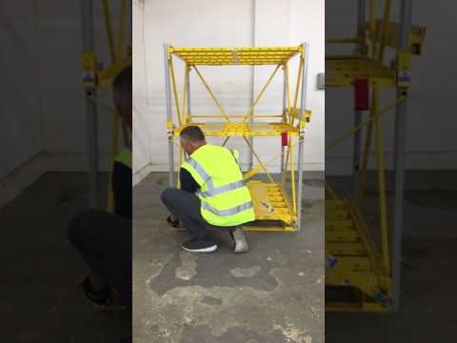
How to use the TriStack SR1000
Please watch the video below

Slide 14
Feedback
We have been working closely with Castledene Transport, part of the Palletline network, to trial and distribute the MultiStack Range.
“We have been using the Danload MultiStack System for a while now and have several different models, used on a variety of loads to make full use of the space we have in our vehicles. It has helped us with being more efficient for our customers who wish to send that extra pallet of goods or something that is light in weight but just a little over size and can be loaded onto the top of the MultiStack so as not to damage any goods below by stacking on them.
A very well designed and made piece of equipment to help the haulier. Danload have listened to all of the requirements that hauliers need to overcome some of the difficulties they have. We thoroughly recommend them we will certainly be buying more.”
Nicky Amey
Castledene Transport

Slide 15
Frequently Asked Questions
• What is the load capacity for each MultiStack?
Each MultiStack base has a carrying capacity of 600KG. Each elevated chassis has a carrying capacity of 300KG.
• How is the MultiStack loaded and unloaded?
The MultiStack can be loaded and unloaded using a forklift. Where no forklift is available the MultiStack can be unloaded using a pallet truck by lowering a truck’s tail lift so the bed of the truck is level with the middle or top chassis. The ramp 500 can then be used to unload the pallet with the pallet truck. Where the tail lift drop only has a 700mm dropping distance, the longer TriRamp will be needed to unload the pallet safely.
• How is the load secured?
The MultiStack range is a method of combining multiple pallets in one space and should therefore be treated as if each MultiStack unit was a separate load. The security of load within each MultiStack system should follow guidelines and regulations on the securing of loads as with all loads. Each pallet or load that is placed on any level of the MultiStack system should be secured by ratchet strap or suitable fastening to the same chassis by the anchorage points provided on the chassis. Each MultiStack should also be crossed fastened to the vehicle individually and/or ratchet strapped or suitable fastening to the vehicles anchorage points.

Slide 16
Frequently Asked Questions
• What accessories are available?
Each MultiStack comes with front cross brace, ramp 500 and load stabilising bar (to be used to be braced off another MultiStack or to an adjacent load or headboard). A longer TriRamp and a soft touch wooden base are also available to purchase separately.
• What size pallet can each MultiStack carry?
The MultiStack range is available in UK (1000mm x 1200mm) or Euro (800mm x 1200mm) pallet sizes.

Slide 17
Contact us
Danload Stacking Systems Ltd.
Office: 01732 240577
Sales: 0794799927
Email: enquiries@danload.co.uk
Managing Director:
Danny Watson d.watson@danload.co.uk
Operations Manager:
Kelly Neath k.neath@danload.co.uk
Correspondence:
c/o McLean Reid, 1 Forstal Road, Aylesford, Kent ME20 7AU

